Slide 1
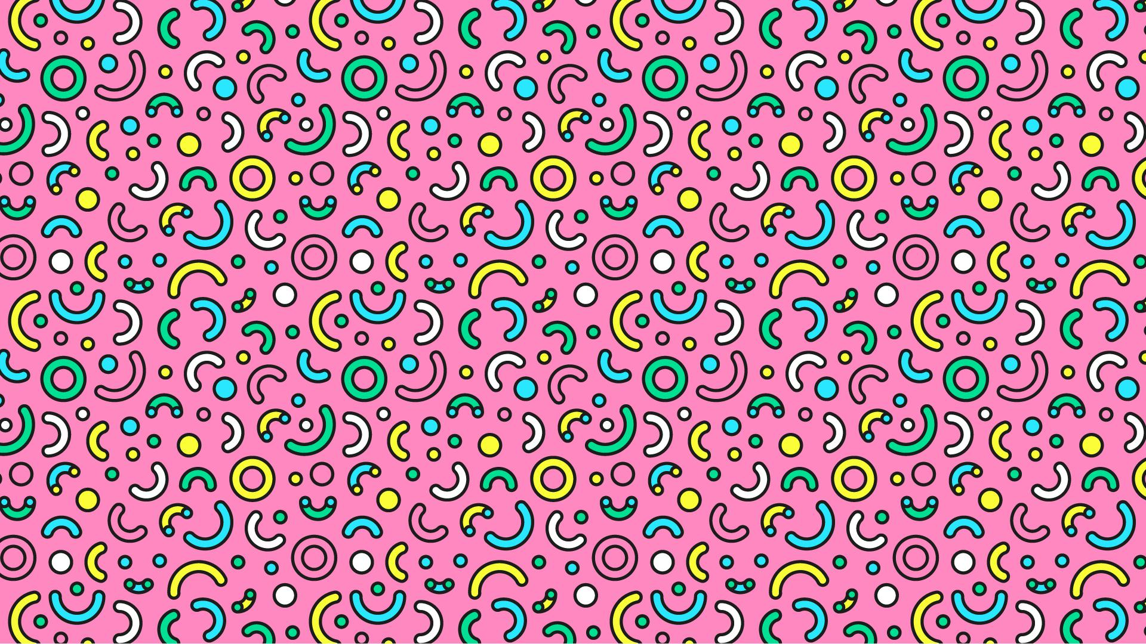
CFG Project
Group 7
Members:
Clara Londoño
Elena Ailenei
Sara Murray
Kelli Garnett
Zsanett Horvath

Slide 2

gloomy
pessimistic
sulky
moody
uninspired
dehydrated

Slide 3
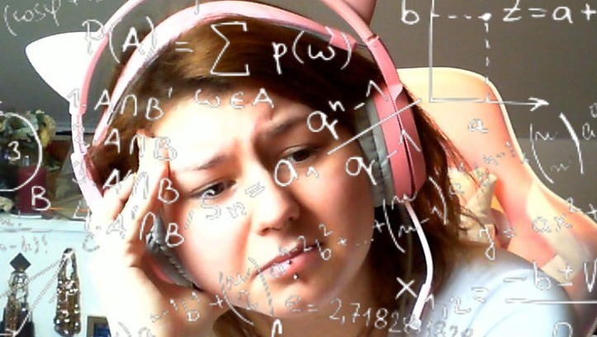
gloomy
pessimistic
sulky
moody
uninspired
dehydrated

Slide 4
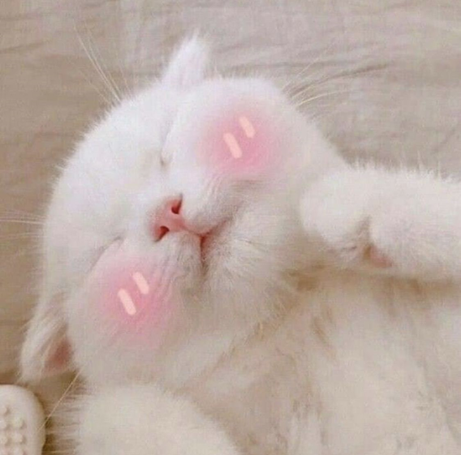

inspired
hydrated
calm
glowing
peaceful
encouraged

Slide 5

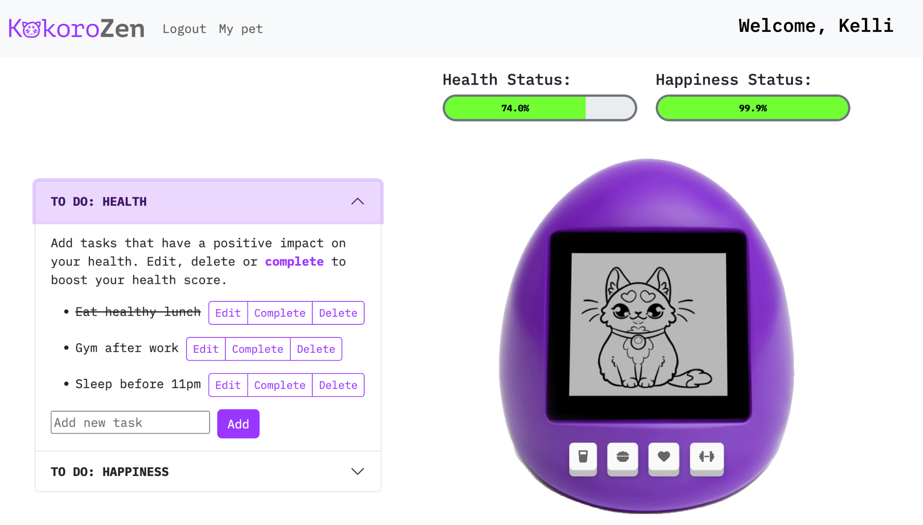


Slide 6
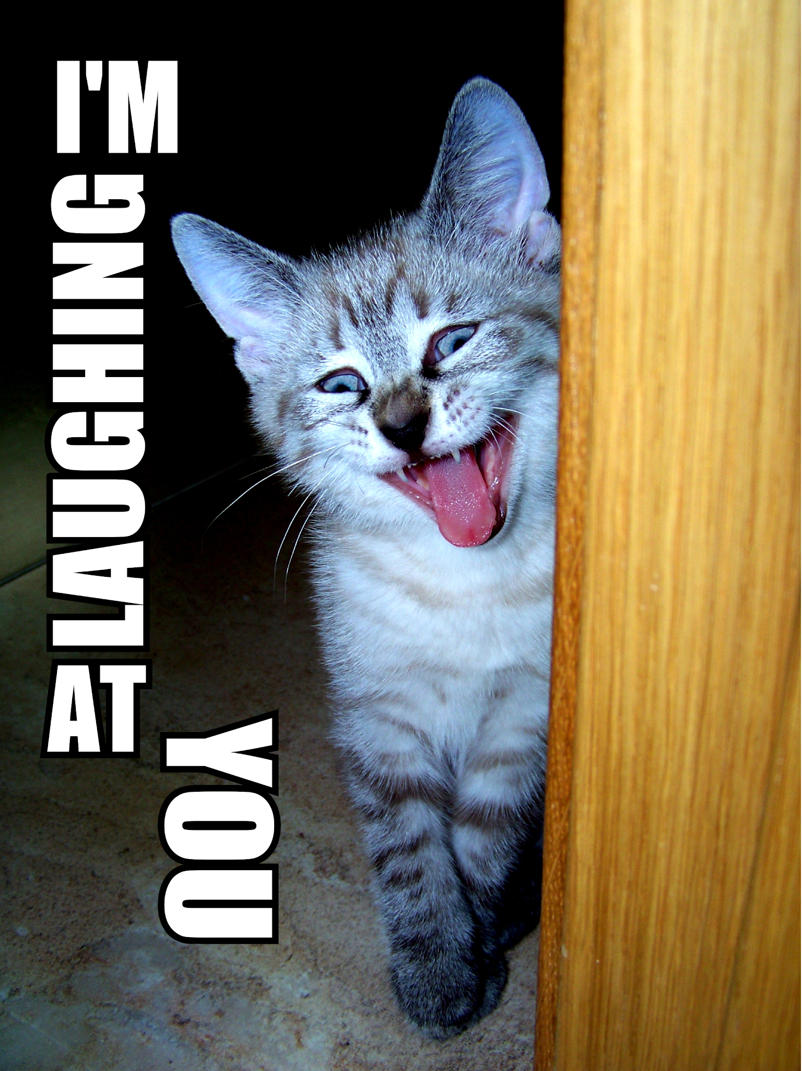
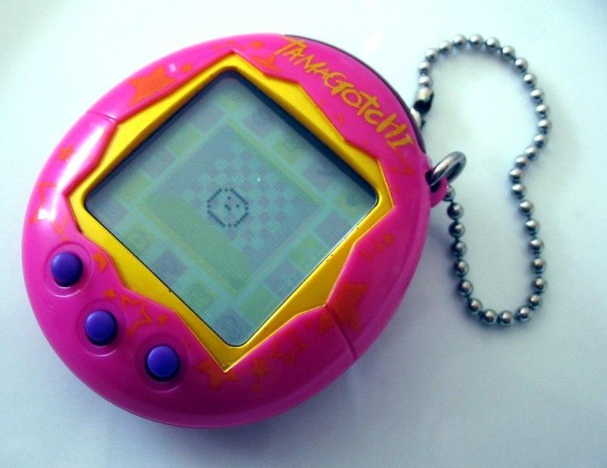
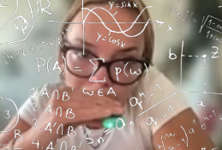
Mental Health
Fix it with a digital cat!

Slide 7

Who is this for?
What problem does
it address?
How does it work?
How do I use it?
Everyone!
Overlooking self-care and maintaining habits in our fast-paced lives.
1
2
Gamified approach to self-improvement, where a virtual pet reflects your well-being.
Sign in, complete tasks or interact with your virtual pet to improve their well-being and enjoy the journey!
3
4

Slide 8
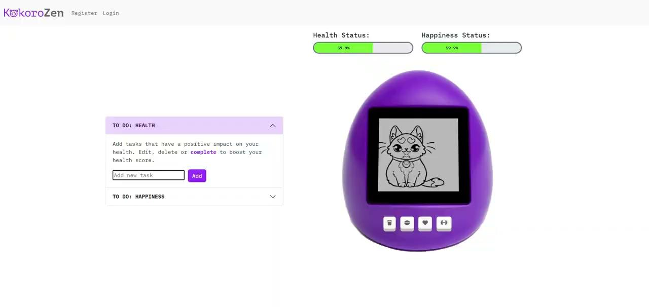

Slide 9
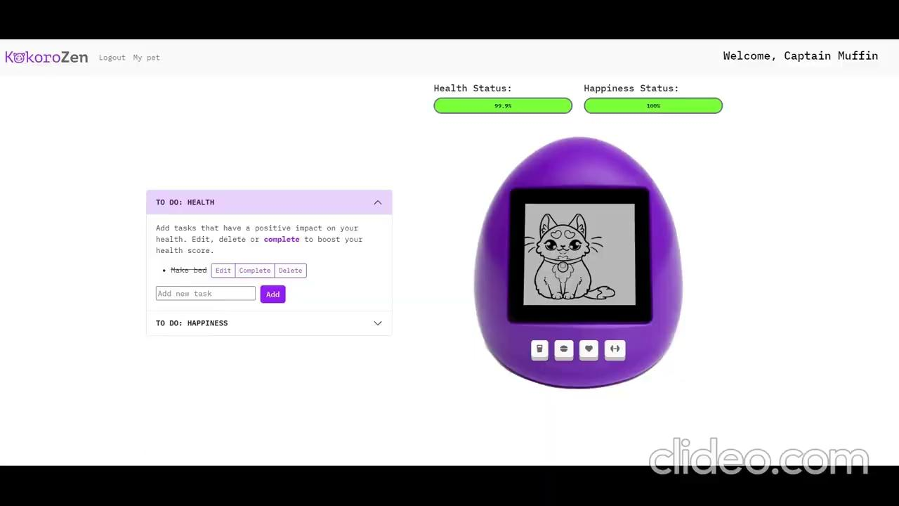

Slide 10
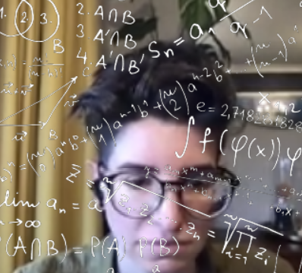
Front end with
KELLI
Let’s explore what the user sees when interacting with our project.

Slide 11
Bootstrap!
<front-end framework/>
Notes:
We used Bootstrap as the front-end framework. This made implementing and customising the look and feel of the web app faster and easier. Instead of building components from scratch, code was copy and pasted to then be customised to fit the specific needs of the web app.

Slide 12
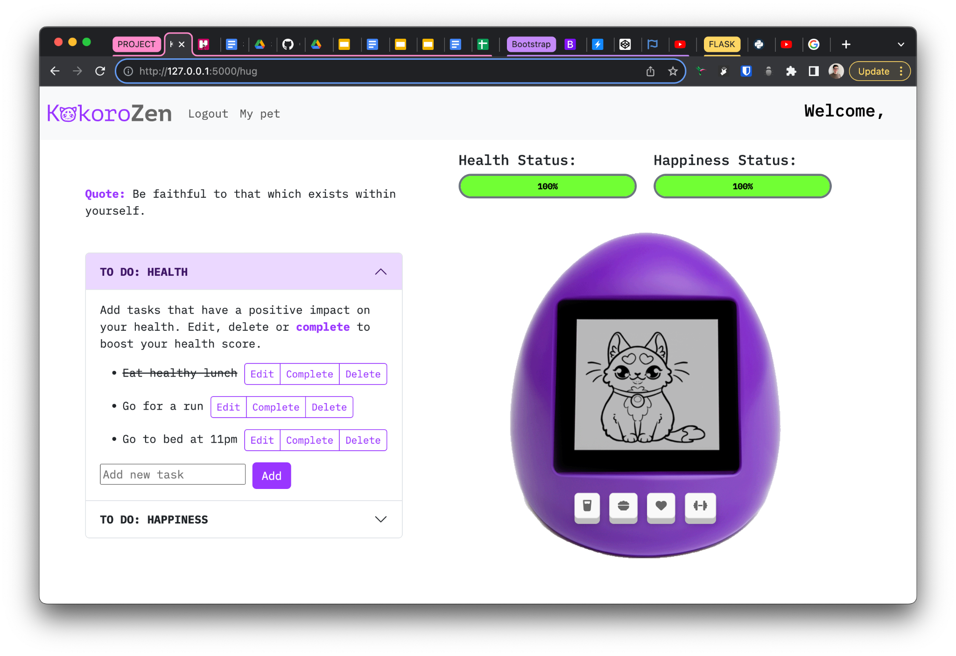

Grid system
NAV BAR
HEALTH METERS
QUOTE
TO-DO LISTS
VIRTUAL PET
Notes:
Bootstrap makes it easy to lay out the sections and elements of a website with their grid system. Our app comprises of 5 main sections.
The top navigation bar and welcome text, left side which has the inspirational quotes and the to-do list accordions, and the right side which has the health & happiness meters and of course the visualisation of the virtual pet

Slide 13

To-Do list
ACCORDIONS
Simple to-do lists become more engaging yet easy to use through the use of the Bootstrap accordions.
Users can edit, complete and delete tasks. The look was easily changed using custom Sass & CSS.
Notes:
A component used to manage the users tasks is the accordion. The user’s to-do list task are split up into two sections and can be easily edited, completed or deleted.

Slide 14
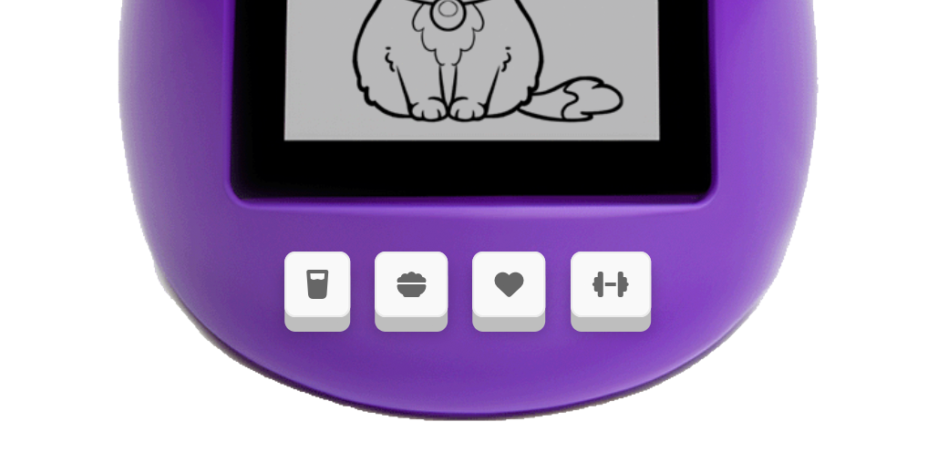
Quick task
buttons!
Glass of water
Easily log every time you drink a glass of water
Bowl of food
Quickly track when you eat a healthy meal
Dumbbell
Hit the gym after work? Easily log your exercises
Notes:
Like the iconic Tamagotchi toy of our past youth, we integrated buttons to simulate tending to your pet’s needs while capturing more repetitive or typical tasks user’s may complete. A water button for keeping hydrating throughout the day, a food bowl button to log when a healthy meal has been eaten and a dumbell for tracking exercise.

Slide 15

Feeling down & uninspired?
— Quotes from API Ninjas
“Put your heart, mind, and soul into even your smallest acts. This is the secret of success.”
Heart
The heart button gives users a happiness boost by providing an inspirational quote
Notes:
The final button is the heart button. Users can give a little love and happiness to their pets happiness meter. This will return an inspirational quote for a little pick me up.

Slide 16
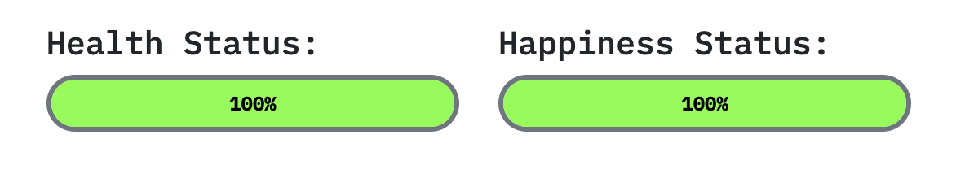
HEALTH & HAPPINESS
Notes:
All of the buttons and task lists link up to the health and happiness meters. Every time a task is completed or a button is clicked the meter ticks up a few percentage points increasing your pet’s health or happiness.

Slide 17
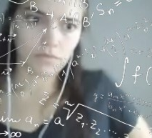
Back that end up with
CLARA!
What goes on behind the scenes?

Slide 18
Python magic with Flask
Local host
Routes
Classes
Flask
Functions
API call

Slide 19
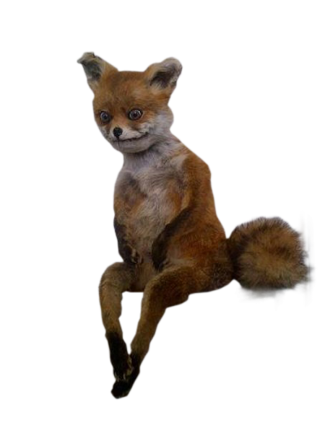
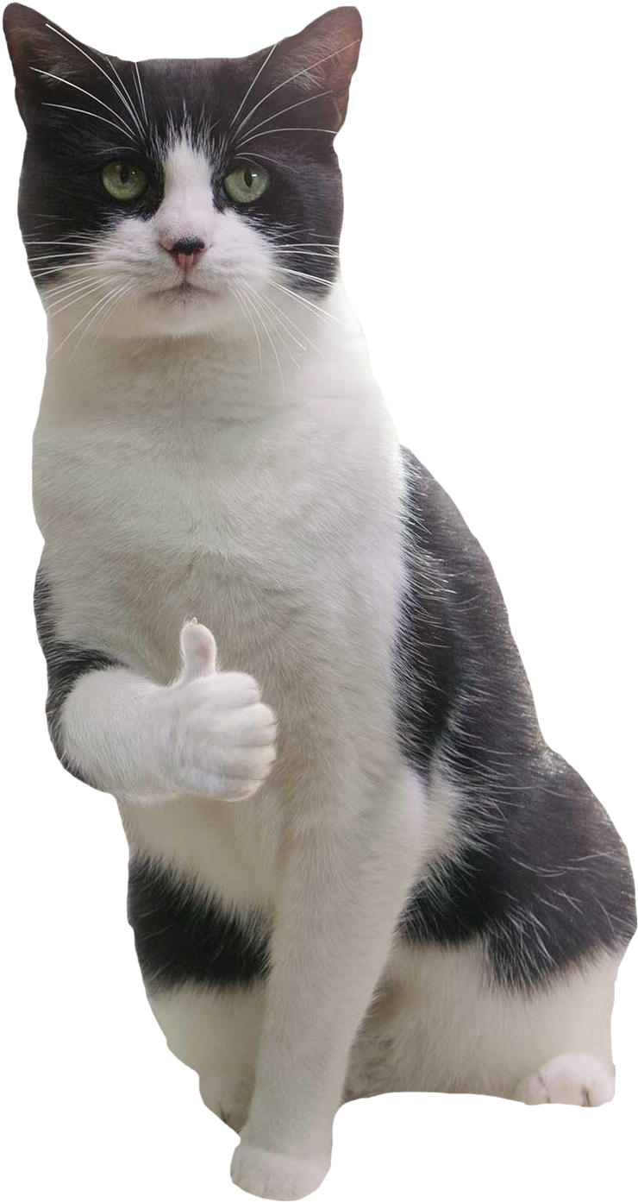
Decay function
Using app
Not using app

Slide 20
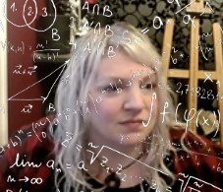
def summary(project, Sara):
# Add humor to conclusion
result = project + " + “ + Sara"
print("Result:", result)
# Call function to add Sara's
# touch to presentation
summary("Our Awesome Project", “Sara”)

Slide 21
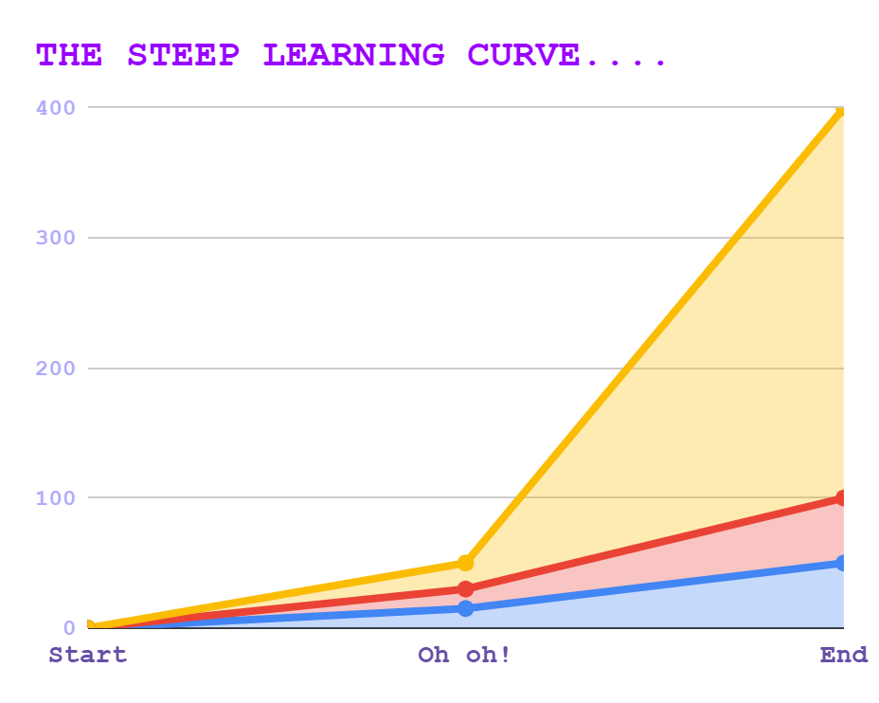
Livin’ La
Vida
LOCA!
Snakes on the Brain
Be less worried about getting straight to code
Just Keep Swimming
More upfront planning would have saved time and implementation issues.
Dream Team
We’re super proud of what we’ve built together

Slide 22
Let’s bounce!
Got……Questions?

